Slide 1
Ipl Data EDA And Prediction's
Pujan Shah

Slide 2
Index.
Summary- (3rd slide)
Information about data (Statistical and corelation information)- (4th slide to 12th slide)
Information we get from data including graphical representation – (13th slide to 33rd slide)
Predictions- (34th slide to 36th slide)
Best ipl team from the data – (37th slide)

Slide 3
Summary.
There are two csv file used in the EDA one has ball to ball data of each match from ipl 2008 to 2020
The other csv file has details of where each match is played i.e. the venue, its results, man of the match etc.
Here we combines the two data sets and then we get the information that we required.
We also get graphs and some corelations between the data.

Slide 4
Information About Data (Ball To Ball data).
The csv of ball to ball data has 18 columns and 193468 rows
The columns are:
ID
Innings
Ball
Batsman
Non-striker
bowler
Batsman_runs

Slide 5
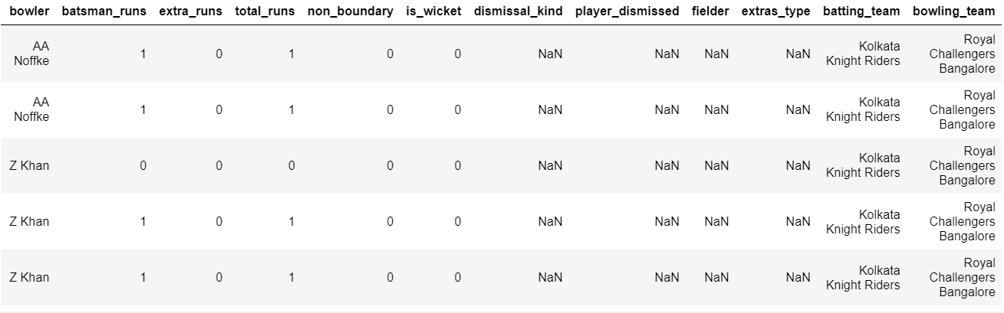
Extra_runs
total_runs
Non_boundary
Is_wicket
Dismissed_kind
Player_dismissed
Fielder
Extra_type
Batting_team
Bowling_team

Slide 6
Information about data (matches data).
Matches csv has 816 rows and 17 columns
Columns are:
id
City
Date
Player_of_match
Venue
Netural_venue
Team 1
Team 2

Slide 7
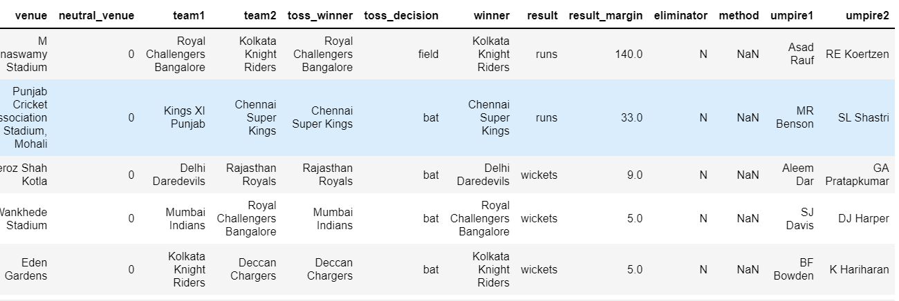
Toss_winner
Toss_decision
Winner
Result
Result_margin
Elimnator
Method
Umpire 1
Umpire 2

Slide 8
Information we get from the data..
Maximum Runs: Z Khan, 6081
Minimum Runs: A Ashish Reddy, 0
Maximum Runs in a season: 2012, 22453
Minimum Runs in a season:2008, 16320

Slide 9

Number of times when team won the toss and won the match
Out of 816 matches 418 matches have been won when the team has won the match .
It means that approx. 52% of matches are won by
Winning the toss.
Blue portion indicates
Match won while winning
Toss

Slide 16
Prediction
So from the above the data we can say that approx. 52% teams have won the match by winning the toss.
As we can see that Mumbai Indians have won the highest number of matches followed by Chennai super kings but we can also see that highest number of matches are played in Mumbai followed by Chennai. So we can predict that if teams get their home ground to play and home support their winning chances are greater. There fore we can say that home team has much better chances of winning the match.
We can also see that highest number of playoffs are played in Mumbai and highest number of matches won by Mumbai Indians in Playoffs.
There fore home advantage place a vital role in winning matches both in league stage and playoff stage.

Slide 17
Continue..
Most of the top scorer of the league are either opening batsman or one down batsman.
Out of 20 top scorer 14 batsman are Indians. We can say that Indians batsman has always been dominating in the league.
Mumbai Indians has won highest toss in the ipl which sometimes plays a vital role in winning matches
In bowlers the highest wicket takers are evenly distributed between spinner and pacers.

Slide 18
Best Ipl team from the current Stats
Players | Players
RG Sharma | Opening batsman(Right Hand)
DA Warner (over sea player) | Opening Batsman(Right Hand)
VK Kohli (VC) | One Down Batsman(Right Hand)
SK Raina | Two Down Batsman(Left Hand)
AB de Villiers (over sea player) | Three Down Batsman(Right Hand)
MS Dhoni ©(WK) | Four Down Batsman(Right Hand)
RA Jadeja | Left Hand All rounder (off spinner)
R Ashwin | Off Spinner (Right Hand)
DJ Bravo (over sea player) | Right Hand All rounder (Medium Pace)
SL Malinga (over sea player) | Medium Pace Bowler
JJ Bumrah | Pace Bowler

Slide 19
Opening batsman are rohit Sharma and David Warner. It is chosen because of right and left combination which will disrupt bowler line and length.
Rohit Sharma average in T20 is 32.48
David Warner Average in t20 is 32.74
One Down is Virat Kohli I don’t need to explain why he is on that position best batsman of the decade with highest total runs in ipl and an average of 51.50.
Two down is SK Raina also known as Mr. IPL second highest run scorer of ipl, Safest hand in Field and can gets wickets when team is needed. Batting average of 32.52
Three down is Ab deVillers also known as mr. 360 can play any shots can turn game in any over of the match and brilliant fielders can take unrealistic catches.
Batting average of 39.7

Slide 20
Four Down is Captain Cool Ms Dhoni which is our team captain. Best finisher of the world can turn a loosing match to win. His presence of mind and match presence can change game at any moment of time in the match. Lightning Fast wicket keeping hands and one of the fittest player and best between running in wickets.
Five down and six down are the best spin duos Ra Jadeja and RV Ashwin the left and right hand spin duo doesn't let the batsman settle for one turn and can get wickets in middle overs. They both can bat pretty well and circulate strikes and Jadeja is also know for his finishing ability and long hitting sixes.
Seven Down is dj Bravo followed by L Malinga and JJ Bumrah bests bowlers dosent need any explanation top 3 bowlers highest wicket takers of ipl.

Slide 21
The team on the previous slides is a well balanced team from the data of 2008 to 2020.
It consist of four over seas player
one opening batsman
finisher
all-rounder
medium pace bowler.
Captain is Ms dhoni because he has the highest winning rate in ipl as captain and vice captain is virat kohli as he has second highest winning rate in ipl after ms dhoni.

Slide 22
Thank you..

